Slide 1

AASD 4000
Machine Learning - I
Applied AI Solutions Developer Program

Slide 2
Module 05 Scikit Learn
Vejey Gandyer

Slide 3
Agenda
Scikit Learn
Importance of Scikit Learn
Setting up scikit-learn
Modeling Process
Estimator API
Use case: Linear Regression problem
Task 6: Linear Regression model
Use case: Unsupervised problem

Slide 4
Scikit Learn
What is it?

Slide 5
What is Scikit-learn ?
Scikit-learn (Sklearn) is the most useful and robust library for machine learning in Python
It provides a selection of efficient tools for machine learning and statistical modeling including classification, regression, clustering and dimensionality reduction via a consistence interface in Python
This library, which is largely written in Python, is built upon NumPy, and uses SciPy and Matplotlib.

Slide 6
Importance of Scikit Learn
Why it is needed?

Slide 7
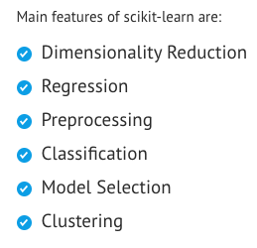
Importance of Scikit Learn
Faster Prototyping
Amazing features enables the machine learning developer to build models faster

Slide 8
Setting up Scikit-learn

Slide 9
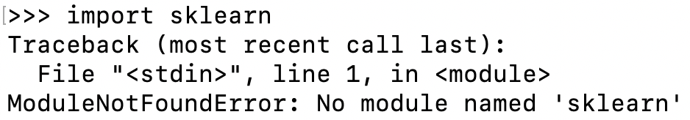
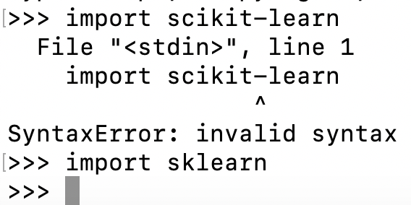
Installing Scikit-learn
Conda / Miniconda:
conda search scikit-learn
conda install scikit-learn
Developer version
conda install -c anaconda git pip install Cython pip install h5py pip install git+git://github.com/scikit-learn/scikit-learn.git
Virtual environment:
pip install –U scikit-learn

Slide 10
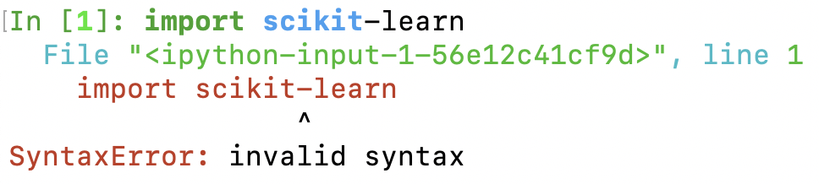
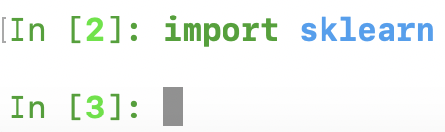
Running Scikit learn
Importing Scikit-learn
Note: sklearn not scikit-learn

Slide 11
Getting Help

Slide 12
Modeling Process

Slide 13
Modeling Process
Modeling Process involves the following steps:
Load the dataset
Preprocess the dataset *
Split the dataset
Train the model
Persist the model
* Detailed in a future lecture

Slide 14
Modeling Process
Loading the dataset

Slide 15
Loading the dataset
Dataset: Collection of data
Features: Variables of data aka predictors, inputs or attributes
Feature matrix: Collection of features
Feature Names: List of all the names of the features
Response: Output variable depends on feature variables aka target, label or output
Response Vector: Used to represent response column
Target Names: Possible values taken by a response vector
Scikit-learn has in-built datasets
Classification: Iris and digits
Regression: Boston House Prices

Slide 16
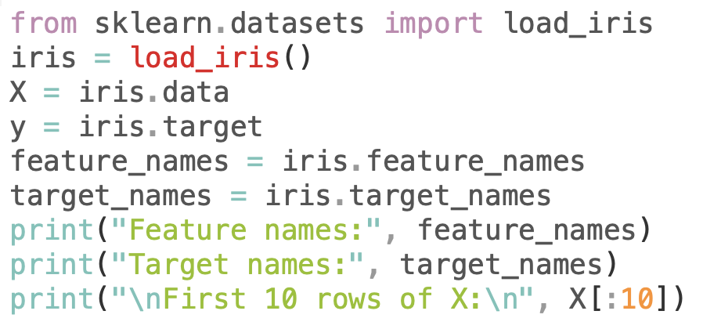
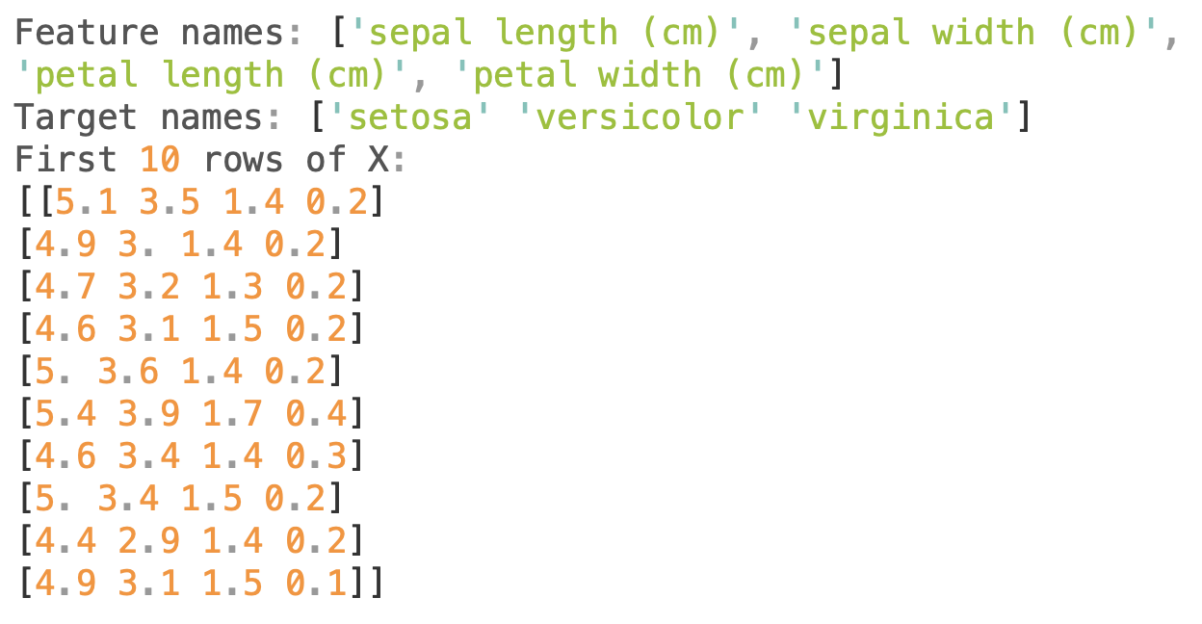

Slide 17
Modeling Process
Preprocess the dataset

Slide 18
Data Preprocessing
Rescaling
Mean Removal
Standardization
Normalization
One Hot Encoding
Binarization
Raw data
Clean data
Imputation
To be seen in detail in a future lecture

Slide 19
Modeling Process
Split the dataset

Slide 20
Splitting the dataset
Training Set: Used to train the model
Testing Set: Used to test the model and not used for training
Split: Ratio of Training Set to Testing Set (70:30 / 80:20)

Slide 21
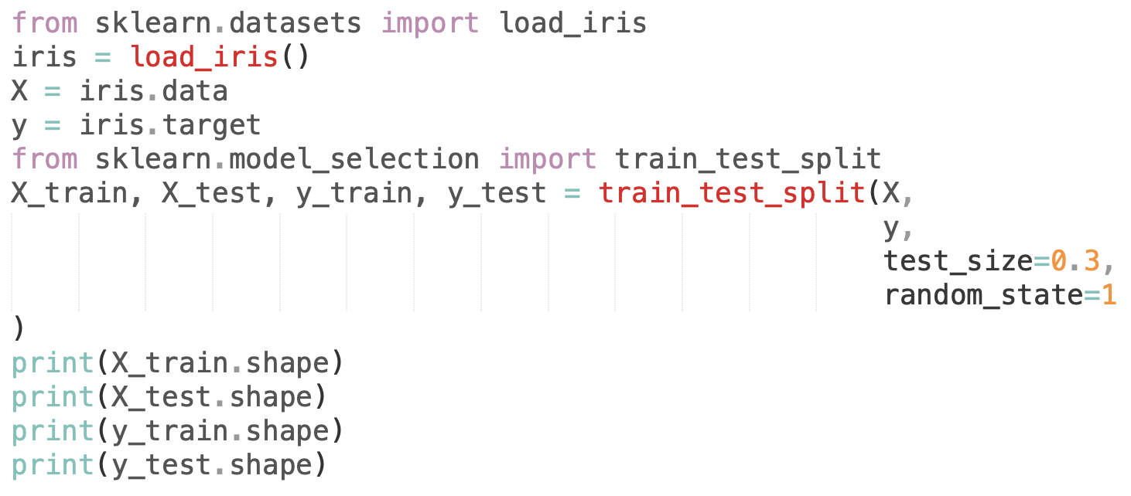
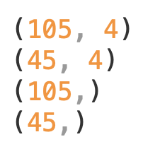
X
y
test_size
random_state

Slide 22
Modeling Process
Train the model

Slide 23
Train the model
Model to be trained using the training set
Choose a model to use
Build an object for the model with specific parameters
Fit the model
Predict for the new unseen data

Slide 24
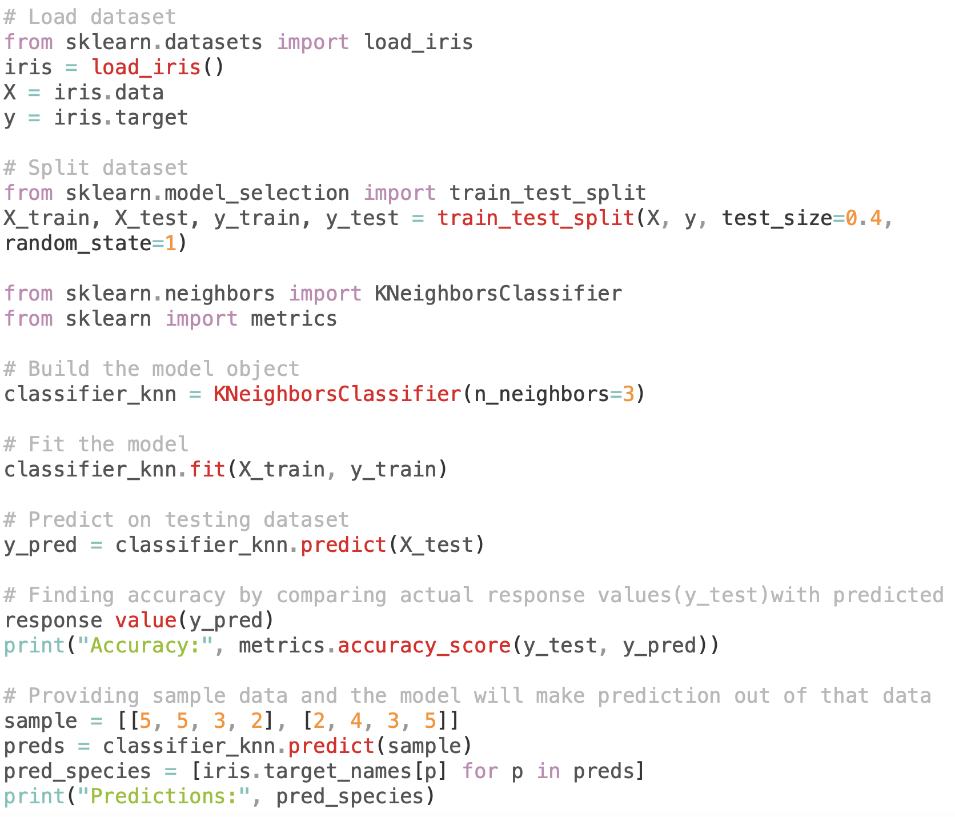
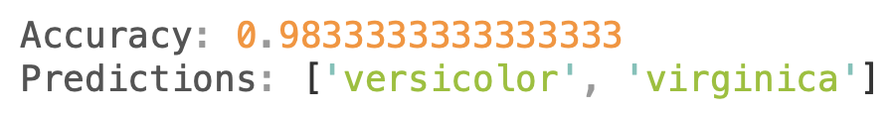
Model - kNN
fit()
predict()

Slide 25
Modeling Process
Persist the model

Slide 26
Persist the model
Trained Model must be stored and persisted for future use
joblib package
dump() - save the trained model
load() - load the stored model for use

Slide 27
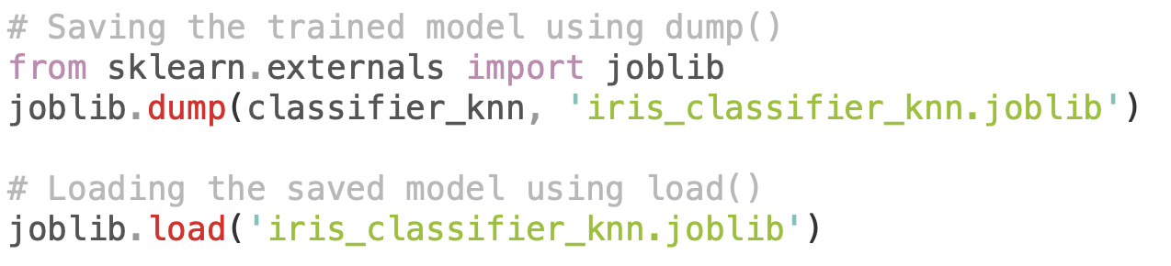
joblib
dump()
load()

Slide 28
Estimator API

Slide 29
Steps in using Estimator API
Choose a class of model
Choose model hyperparameters
Arranging the data for the model
Model Fitting
Applying the model

Slide 30
#1 - Choosing a model
Choosing a model is as simple as importing the appropriate Estimator class from Sklearn package
Model: LinearRegression

Slide 31
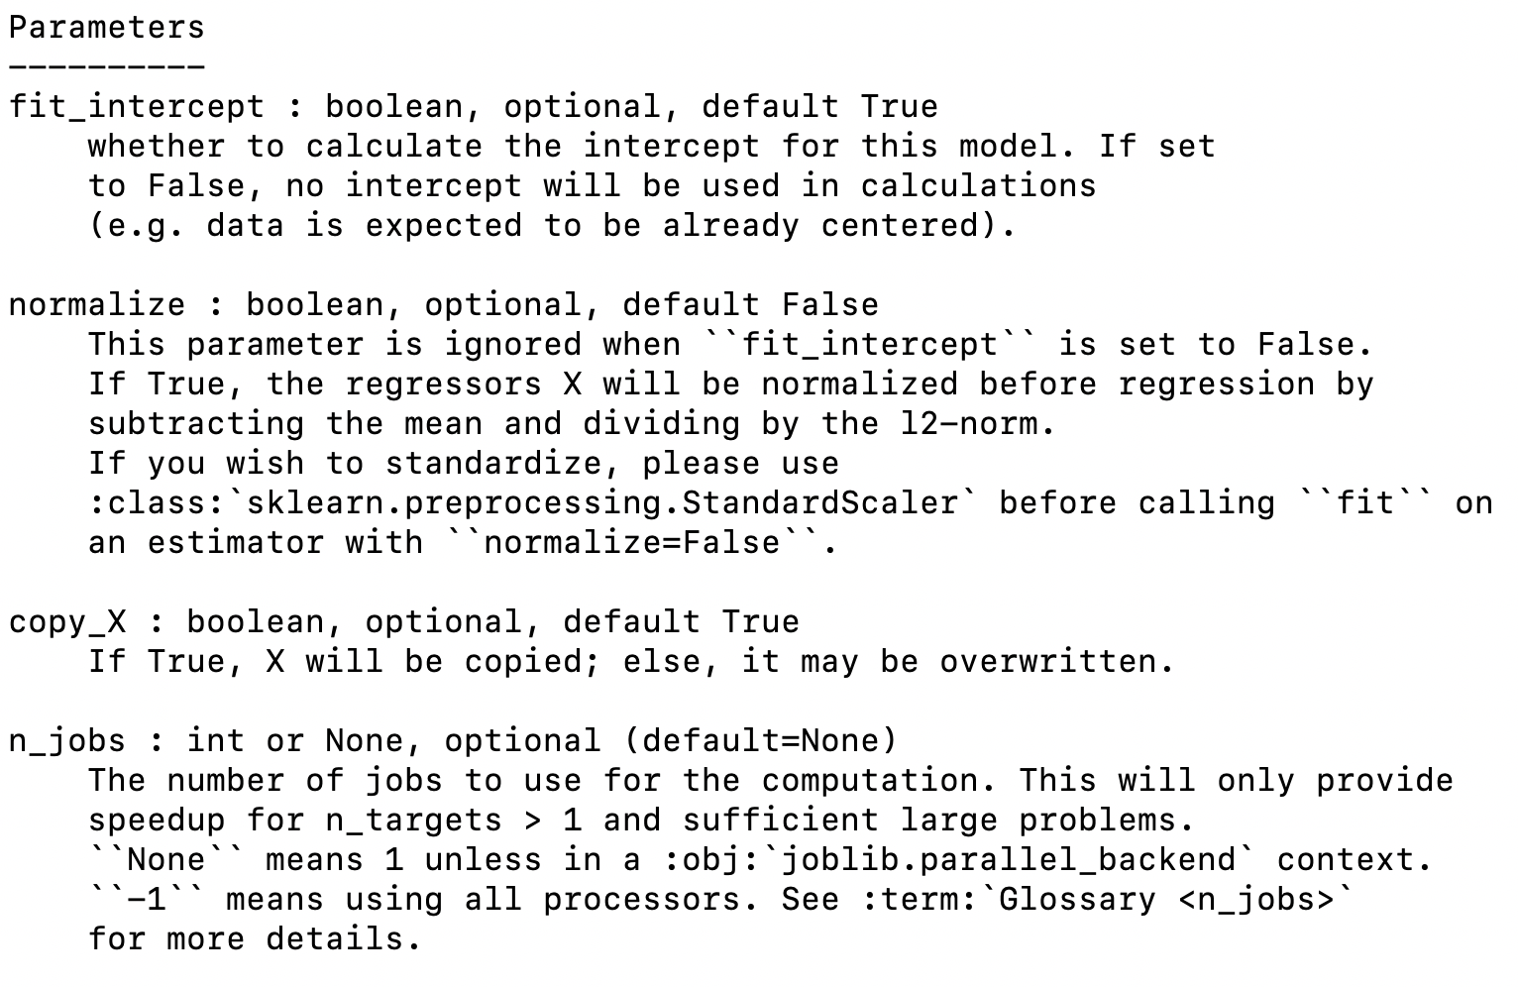
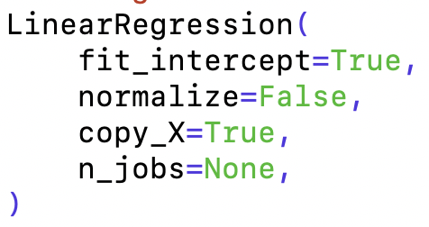
#2 - Choosing model hyperparameters
Look at all hyperparamaters for a model in its signature
Hyperparameter: fit_intercept

Slide 32
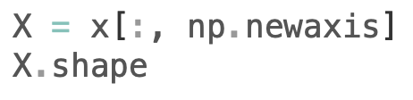
#3 - Arranging the data
Arrange X, y in its correct dimensions
y - target variable of length n_samples (1D array)
X - feature matrix of size n_samples x n_features
Output:

Slide 33
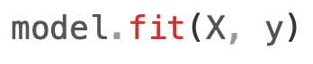
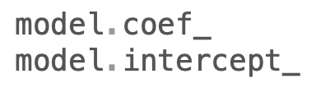
#4 - Fitting the model
Model training happens here
fit()
Output:

Slide 34
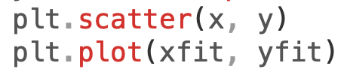
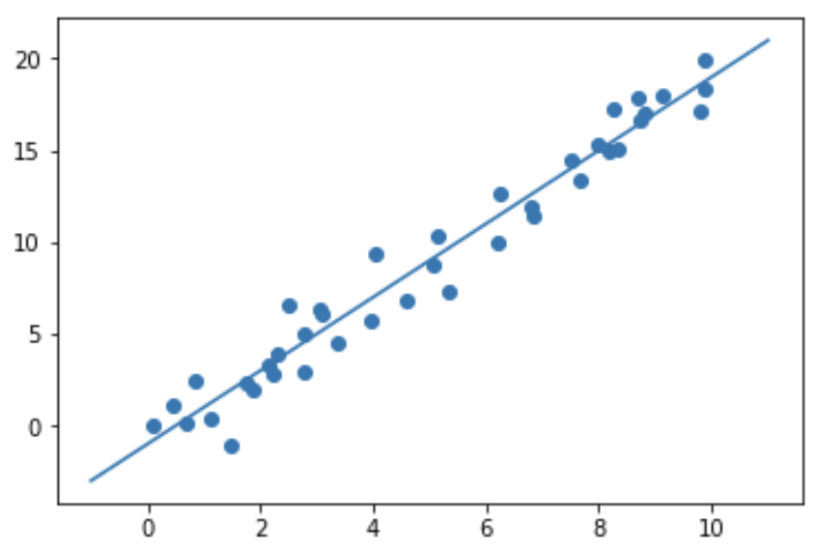
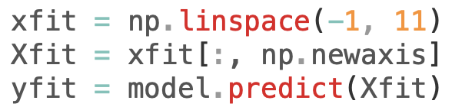
#5 - Applying the model
Output:
Apply the model to the new unseen test data
Classification problem: predict()
Unsupervised problem: fit() / transform()

Slide 35
Recap: 5 Easy Steps in using Estimator API
Choose a class of model
Choose model hyperparameters
Arranging the data for the model
Model Fitting
Applying the model

Slide 36
Estimator API
Scikit-learn Cheatsheet
https://scikit-learn.org/stable/tutorial/machine_learning_map/index.html

Slide 37
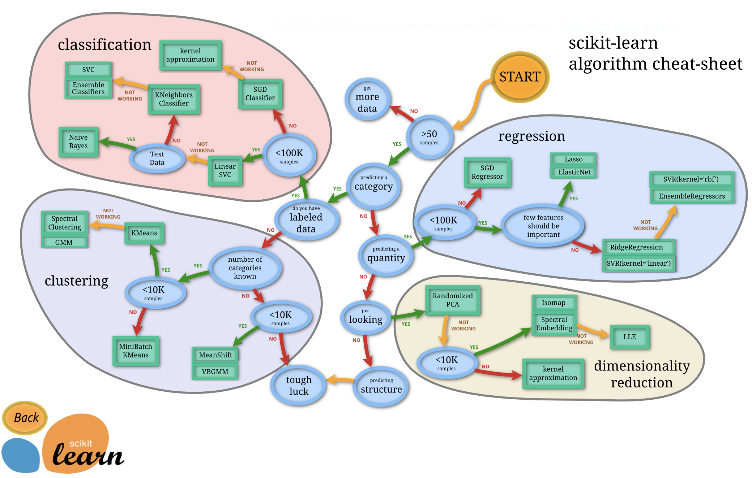

Slide 38
Regression Problem
Task 6: Create a Linear Regression model for Real Estate Housing Prices

Slide 39
Task 6: Create a Linear Regression model
Use the previous code scripts in creating a Linear Regression model for the below dataset
Real Estate Housing Prices Dataset

Slide 40
Unsupervised Problem

Slide 41
Steps in using Estimator API
Choose a class of model
Choose model hyperparameters
Model Fitting
Transform the data
Visualizing the model

Slide 42
Choosing a model
Choosing a model is as simple as importing the appropriate Estimator class from Sklearn package
Model: PCA (Principal Component Analysis)

Slide 43
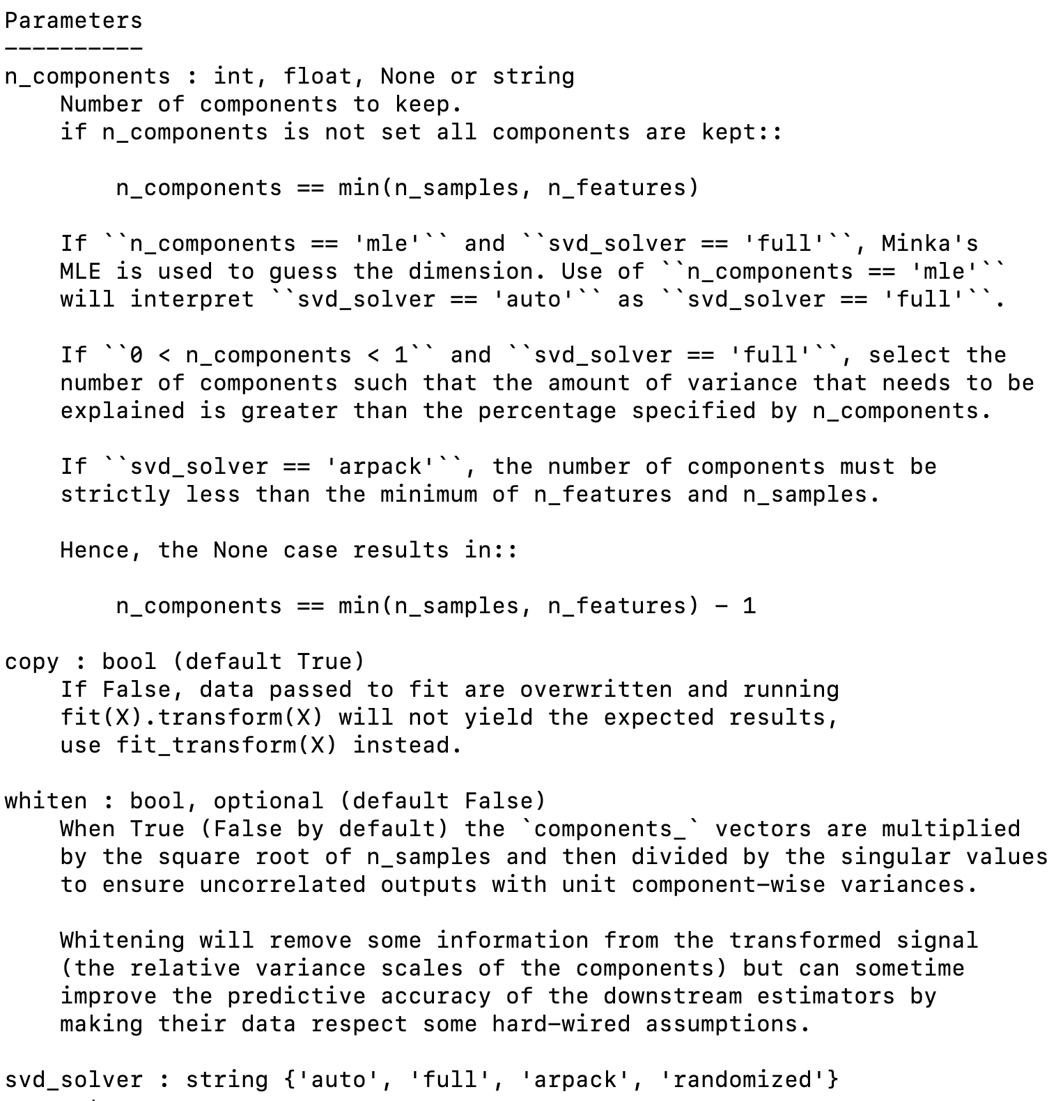
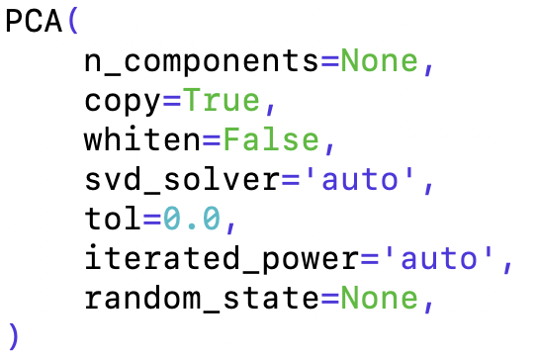
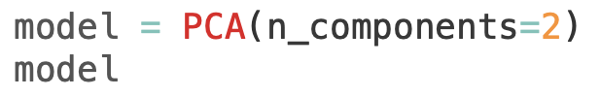
Choosing model hyperparameters
Look at all hyperparamaters for a model in its signature
Hyperparameter: n_components

Slide 44
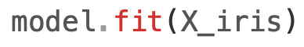
Fitting the model
Model training happens here
fit()
Output:

Slide 45
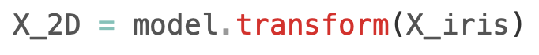
Transform the data
For PCA, no predict()
Note transform() method

Slide 46
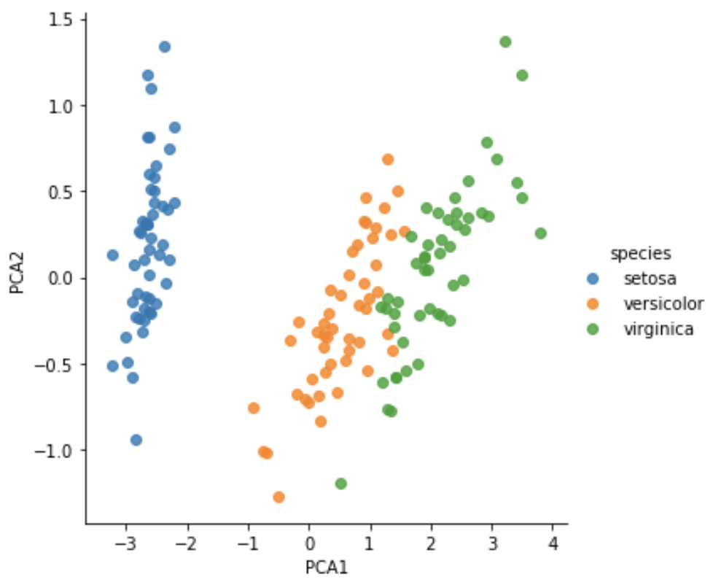
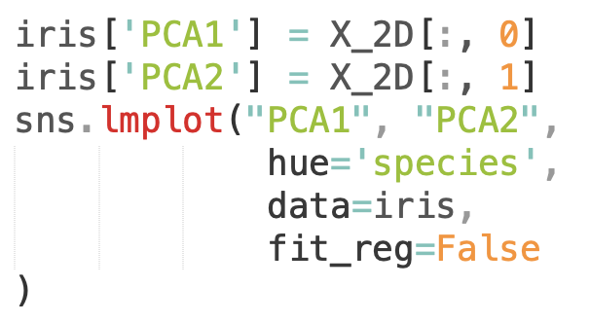
Visualizing the transformed data
Output:

Slide 47
References & Further Reading
Scikit-learn
https://scikit-learn.org/stable/user_guide.html
Kevin Markham (Data School) on using Scikit-learn
https://www.youtube.com/playlist?list=PL5-da3qGB5ICeMbQuqbbCOQWcS6OYBr5A

